Slide 1
Software Requirements specification (SRS) for Fraction Worksheet Creator
Prepared by Elementary Engineers:
Olga Sheehan, Sara Hakkoum,
Eric Holm, Ethan Fieiro
Framingham State University
2016

Slide 2
Introduction
1.1 Purpose
give a detailed description of the requirements for the “Fraction Worksheet Creator” (FWC) software
explain system constraints, interface and interactions with other external applications
to be proposed to a customer for its approval and a reference for developing the first version of the system for the development team
1.2 Product Scope
is an off-line worksheet generation tool to help elementary school teachers to create a lot of exercises for students to study and practice fractions.
1.3 Intender Audience
To be read by the customer, development team, the project managers, testers, documentation writers and end users.

Slide 3
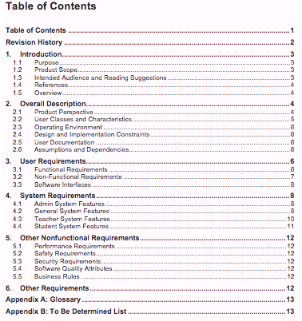
INTRODUCTION
1.5. Overview

Slide 4
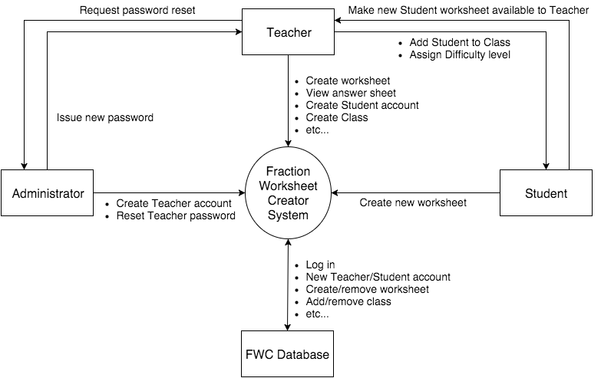
Description
2.1 Product Perspective
Figure 1 – Context diagram for release 1.0 of the Fraction Worksheet Creator

Slide 5
User Requirements
3.1 Functional Requirements
- Requirement for the Admin
- General System Features
- Teacher System Features
- Student System Features
3.2 Non-Functional Requirements
-OS systems it should run on
- System should have access to a printer

Slide 6
User Requirements continued
3.3 Software Interfaces
- will interface with a database
- interface with a API
- interface with Adobe Reader

Slide 7
System Requirements
4.1 Admin System Features
4.1.1 Teacher Registration
- Register Teachers Accounts
4.1.2 Teacher Password Reset
- Admin shall reset teachers account passwords
- Generates a randomly generated password

Slide 8
System requirements continued
4.2 General System features
4.2.1 Admin Account Setup
4.2.2 Graphical User Interface
4.2.3 Help System
4.2.4 Tutorial content
Random Exercise Generation
Worksheet Instructions
PDF Options
Search Features

Slide 9
System Requirements Continued
4.3 Teacher System Features
- 4.3.1 Teacher System Access
- 4.3.2 Teacher Password Reset
- 4.3.3 Teacher Worksheet Selection
- 4.3.4 Worksheet Parameter Option
- 4.3.5 Student Worksheet Review
- 4.3.6 Student Worksheet Deletion
- 4.3.7 Class Roster Creation
- 4.3.8 Student Login Management
- 4.3.9 Student Difficulty Managament

Slide 10
Other nonfunctional Requirements
5.1 Performance Requirements
-Number of Users shall not be limited
5.2 Safety Requirements
-None have been identified
5.3 Security Requirements
- Only allow authorized users
- Require username and password
- Securely Store password in a database
5.4 Software Quality Attributes
- Correctness
- Interoperability
- Usability

Slide 11
Other Nonfunctional Requirements continued
5.5 Business Rules
- Do not allow students to register
- Allow teachers to register student accounts
- Allow the administrator to register teacher accounts
- Allow students to generate worksheets
- Allow teachers to view answer sheets
- Access previously created worksheets

Slide 12
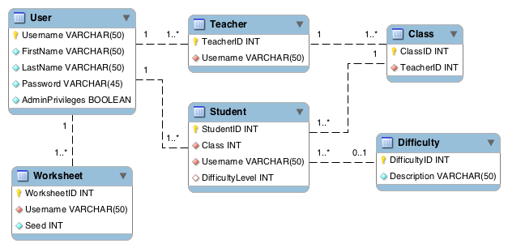
Other Requirements
6.1 Database Schema

